Slide 1

Bat Echolocation Detection
Bety Rostandy (brostandy)
Hadi Soufi (HadiSoufi)
Kevin Keomalaythong (kkeomalaythong)
Thien Le (InsertGithubUsernameHere)
Yang Peng (yangp18)
CSC 505 | 10.17.2018
Progress Report 2
Notes:
everyone

Slide 2
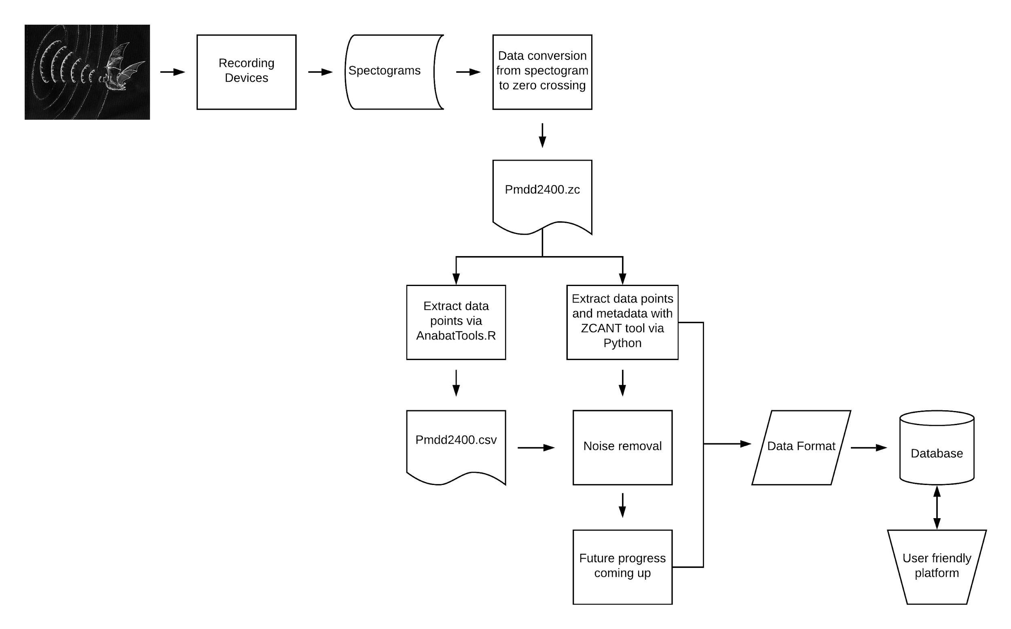
Current Workflow
Notes:
Bety

Slide 3
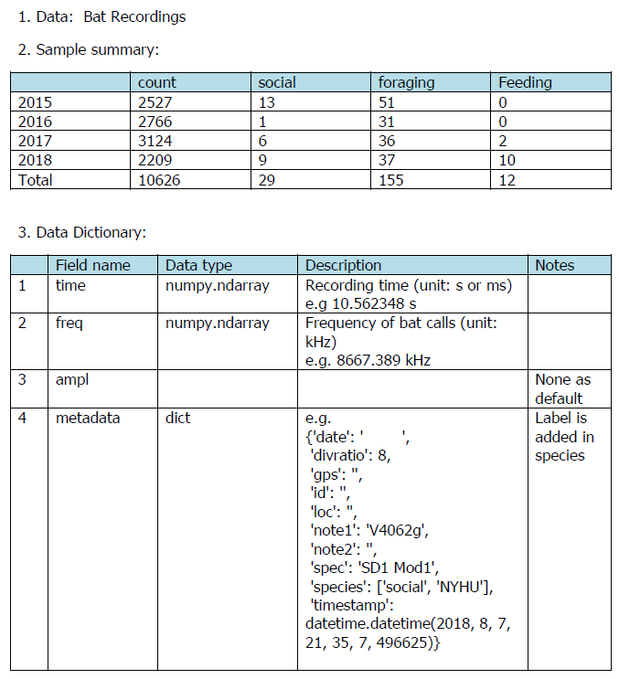
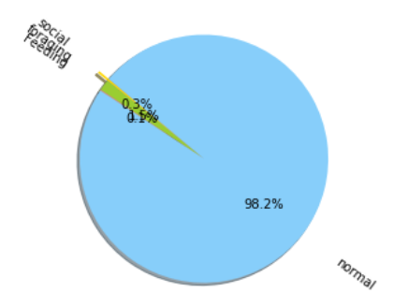
Progress - Yang Peng
Notes:
librosa data visualization package
Task by Member
Progress made towards the task.
If background research - describe it.
If coding - show outcomes.

Slide 4
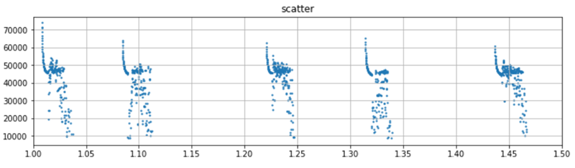
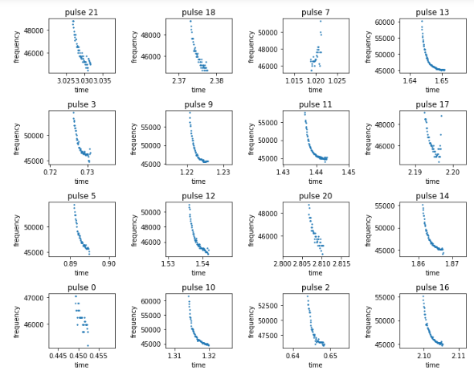
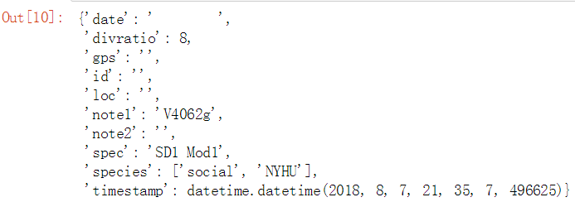
Progress - Yang Peng
bat.py module:
extract_anabat: read original zero-crossing file and return time, frequency, amplitude and metadata (modified from ZCANT package).
remove_noise:read time and frequency and return noise-removed pulses(based on Hadi's approach 3)
display_pulses: visualize extracted pulses
get_labeled_file: search the abnormal labeled file names in a folder
Notes:
librosa data visualization package
Task by Member
Progress made towards the task.
If background research - describe it.
If coding - show outcomes.

Slide 5
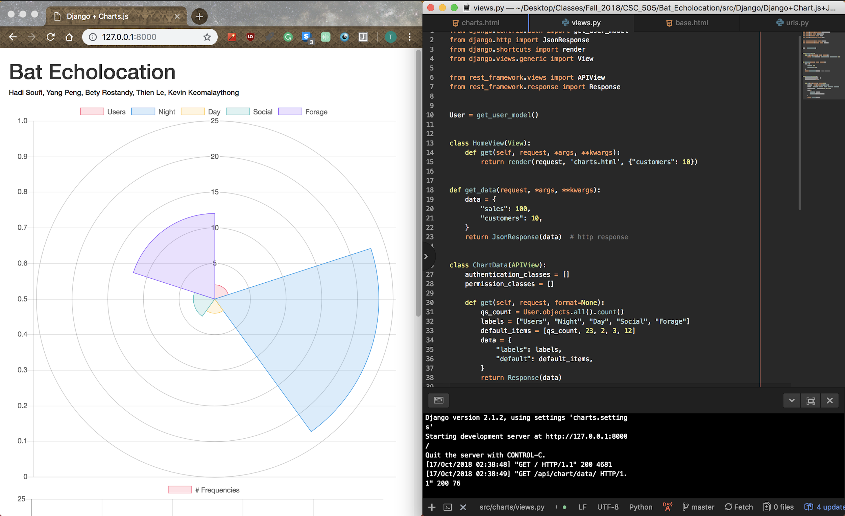
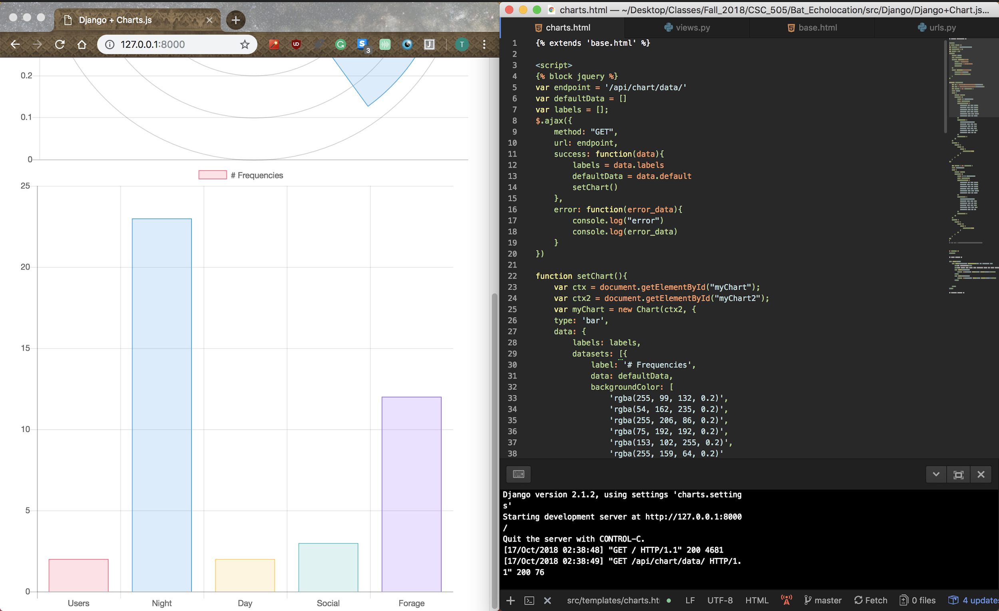
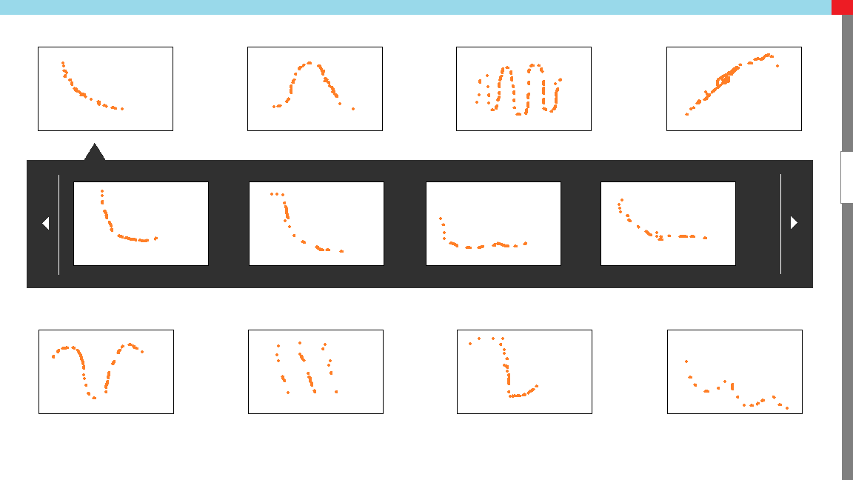
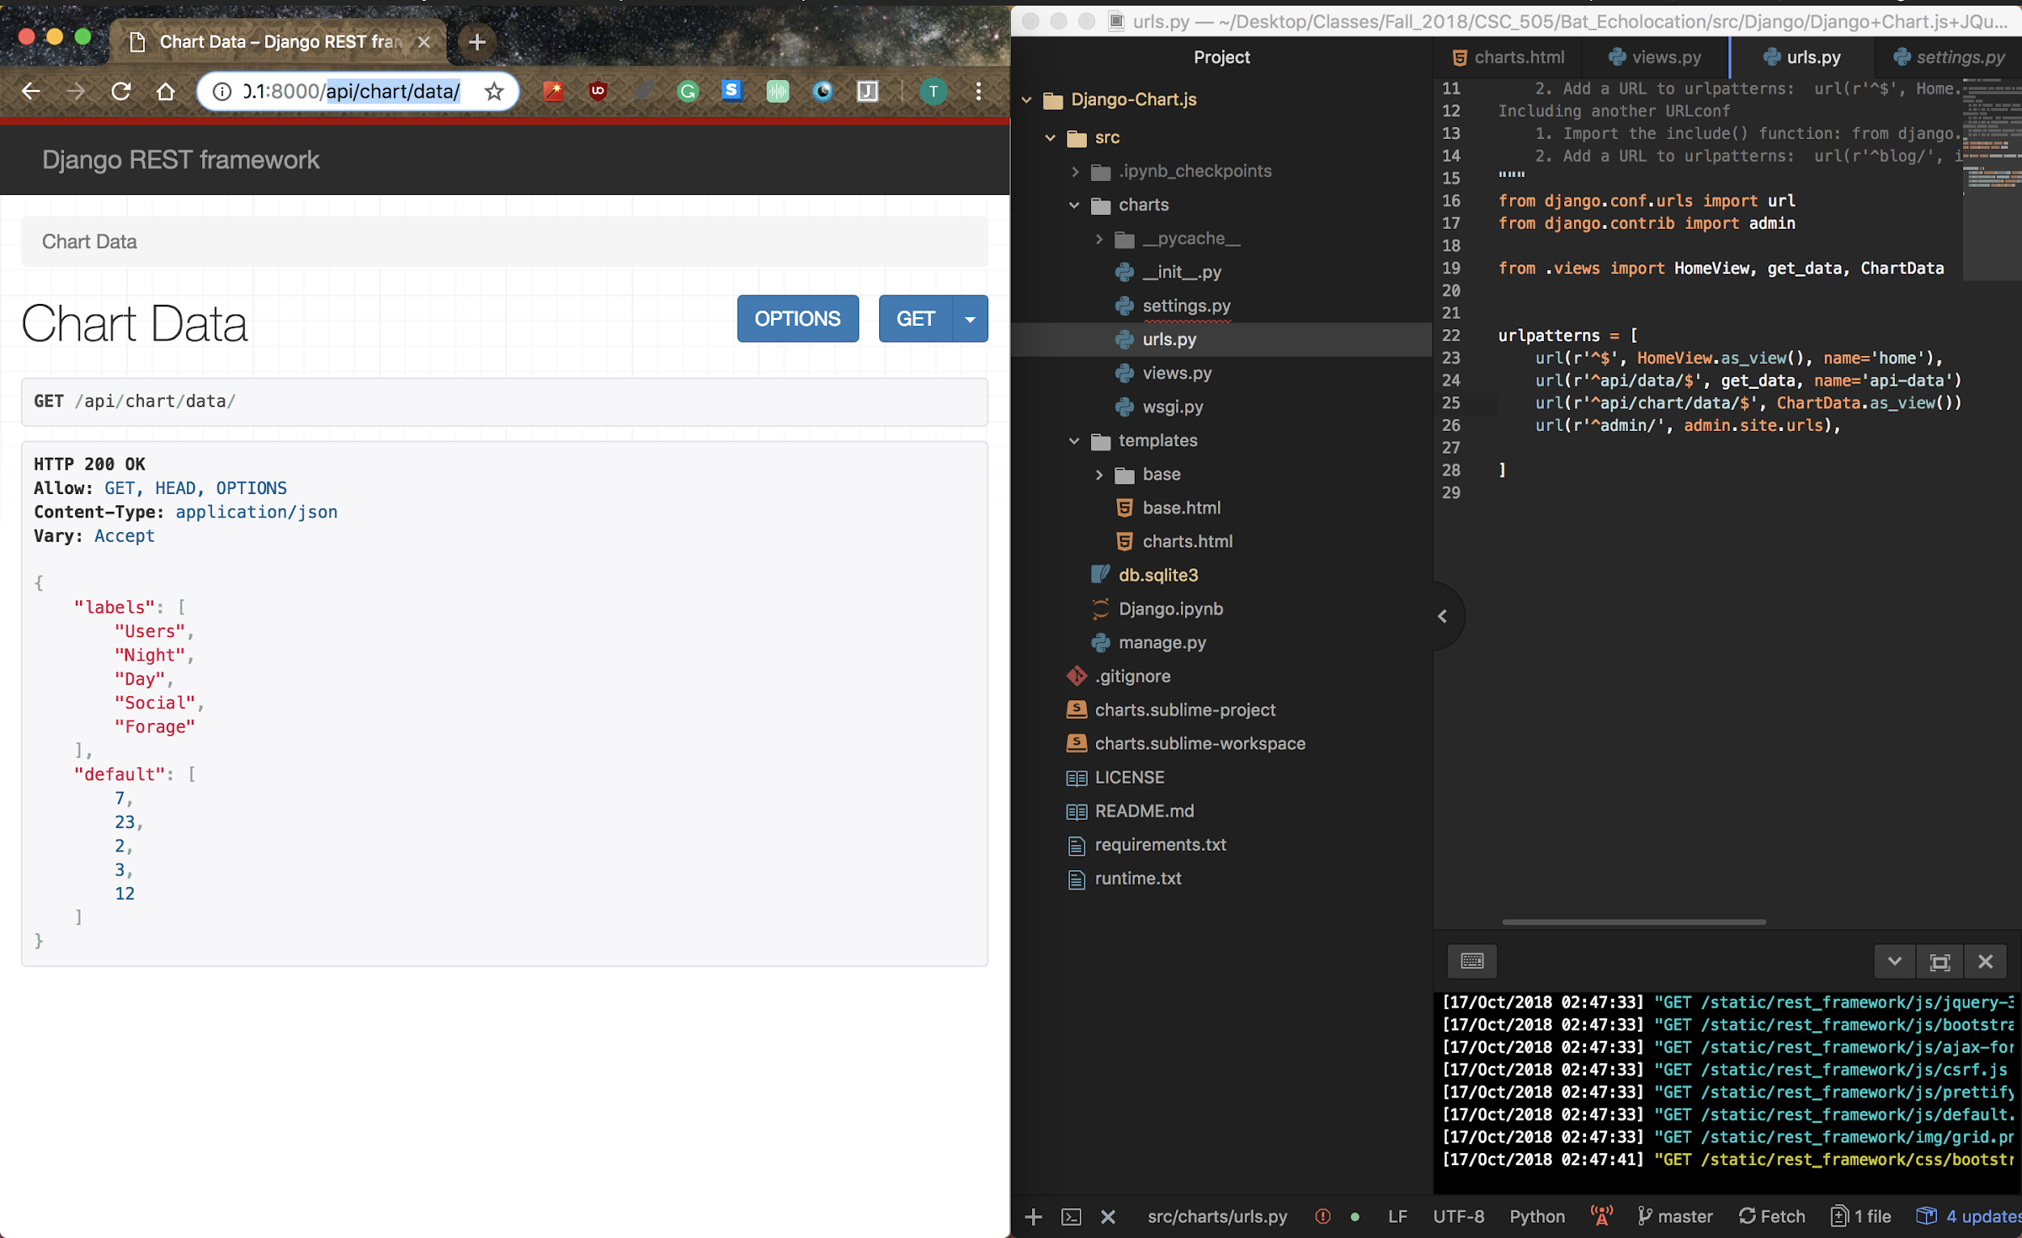
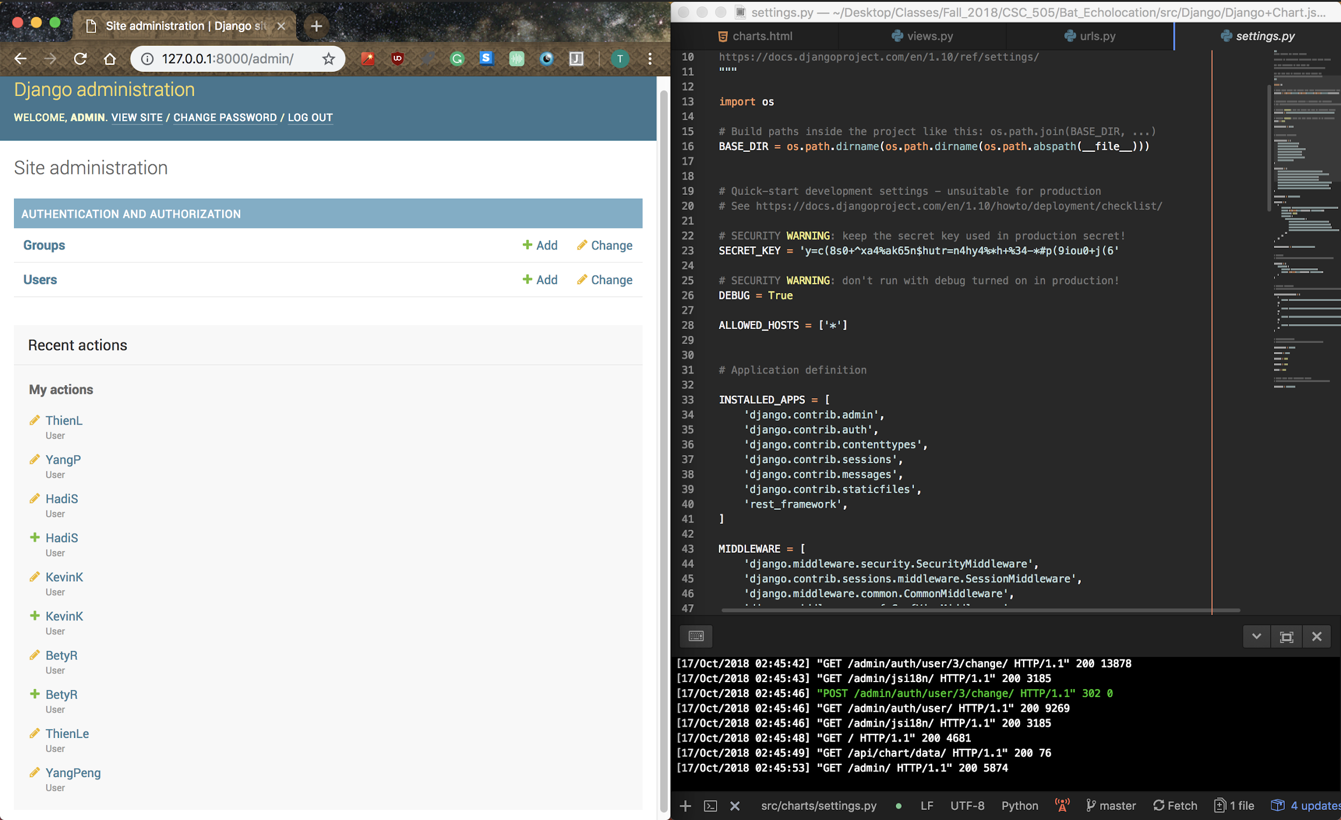
Platform Progress - Thien Le
Django REST API
Admin
Home Page View
Home View cont.
Prototype GUI

Slide 6
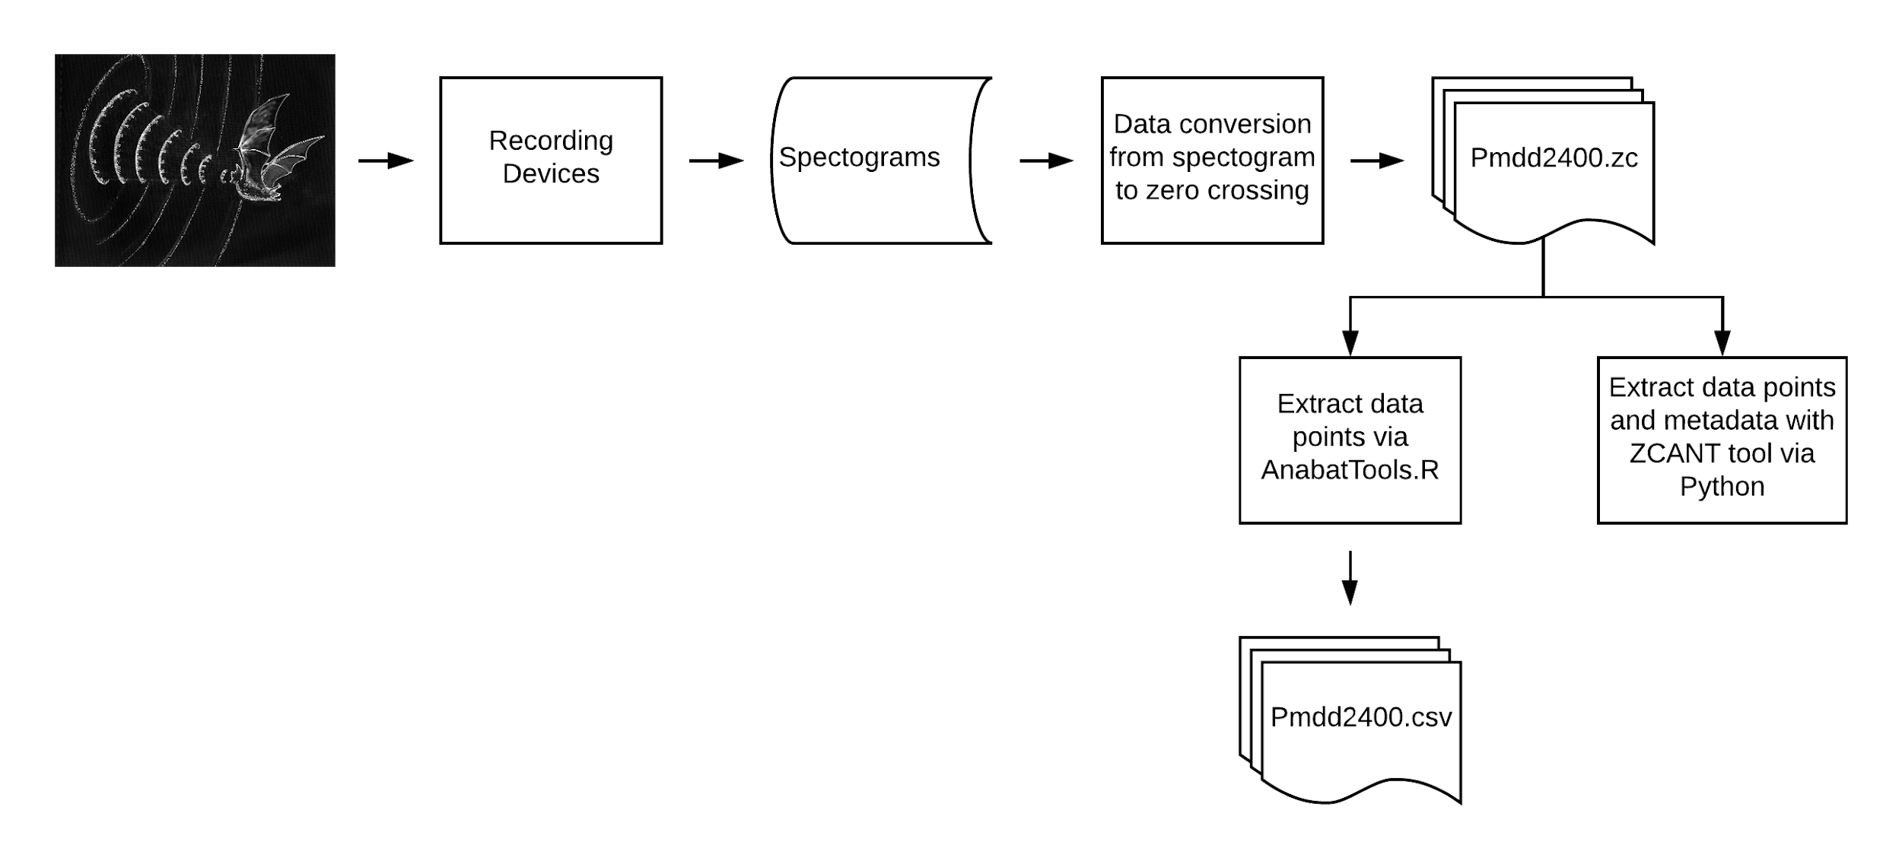
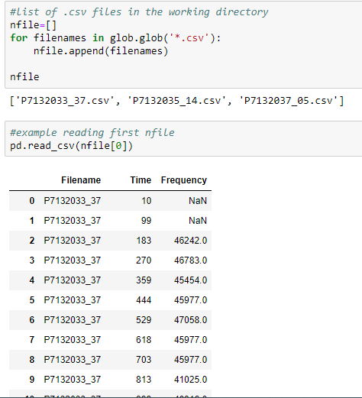
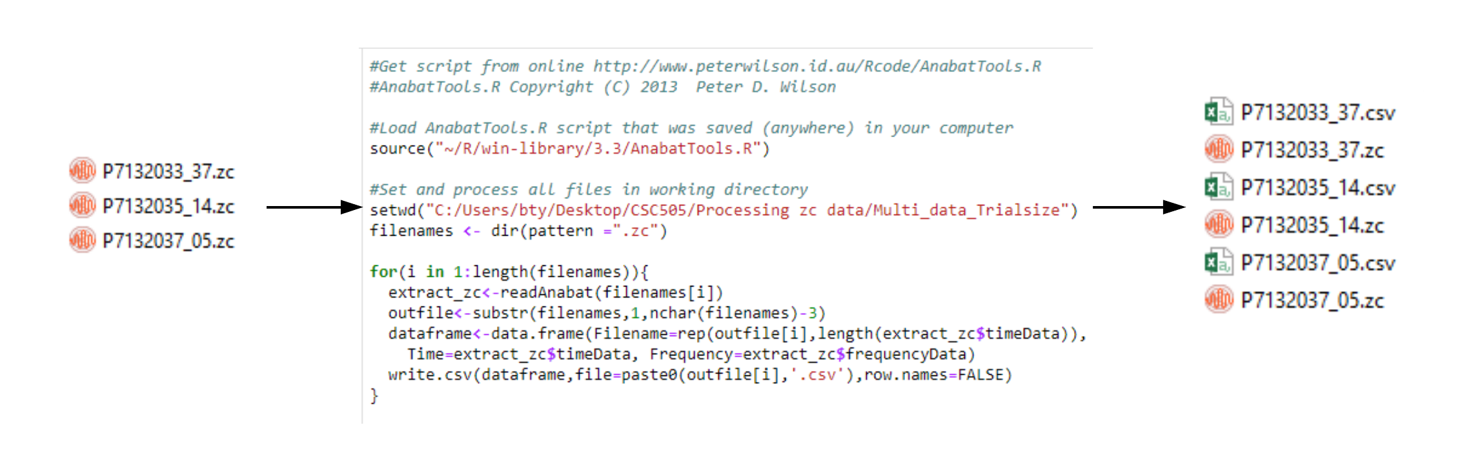
Multiprocessing Progress

Slide 7
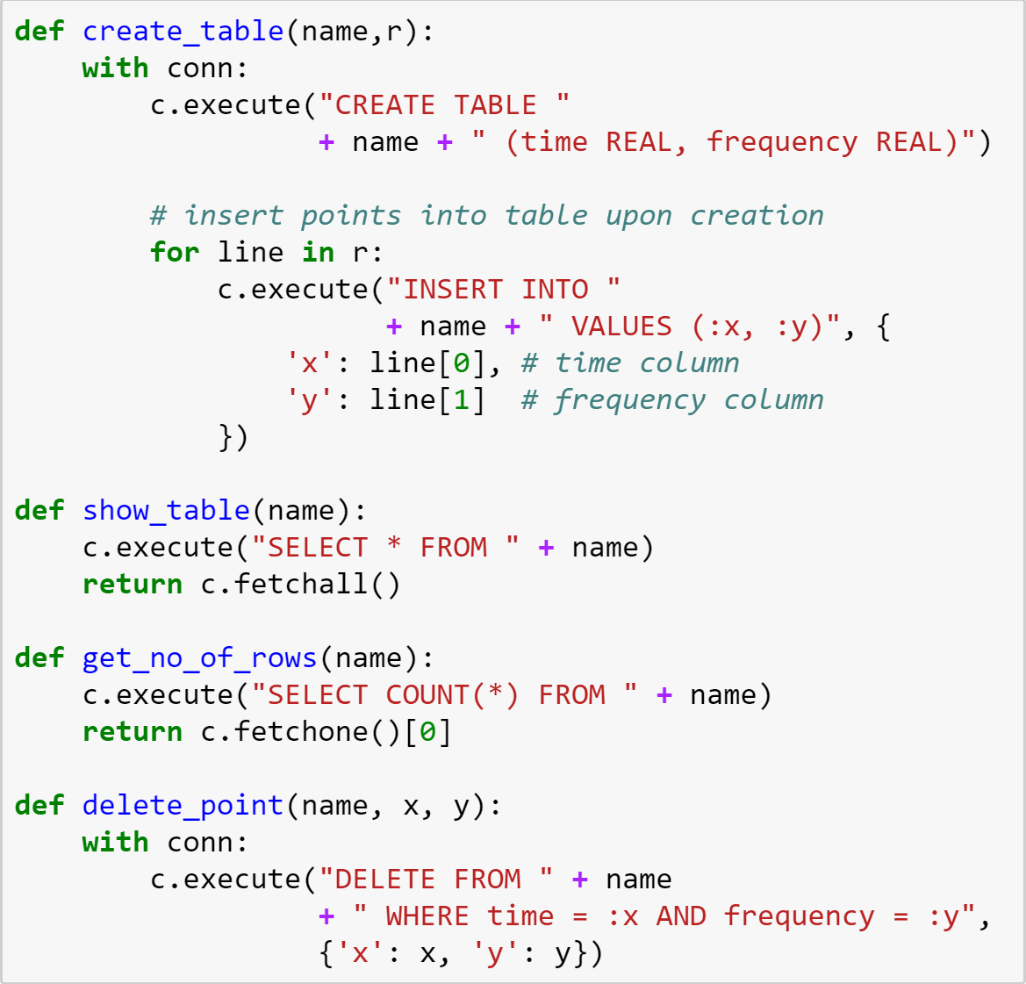
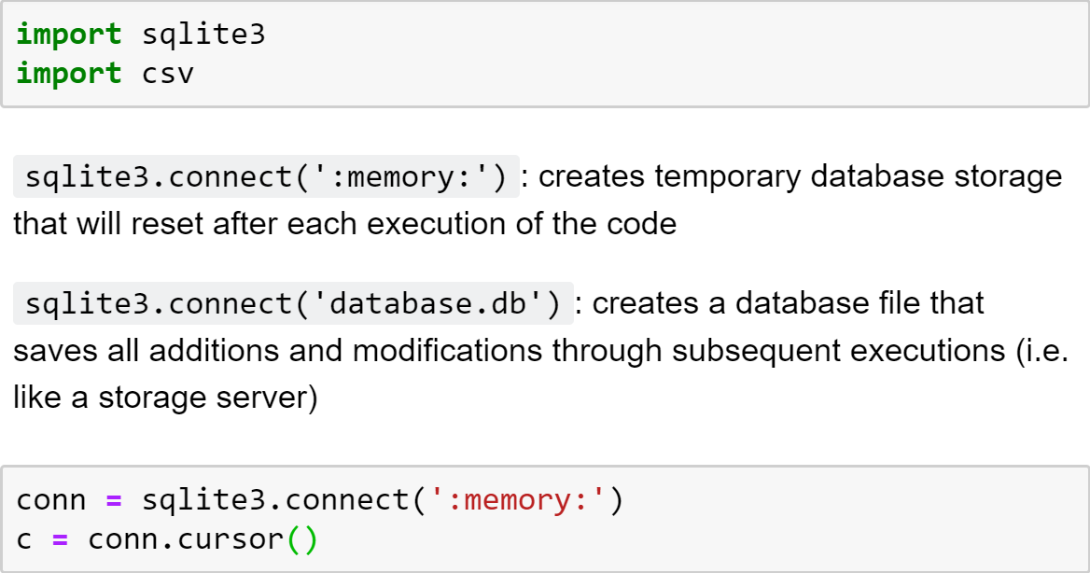
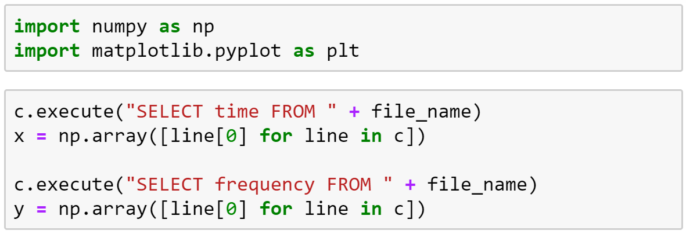
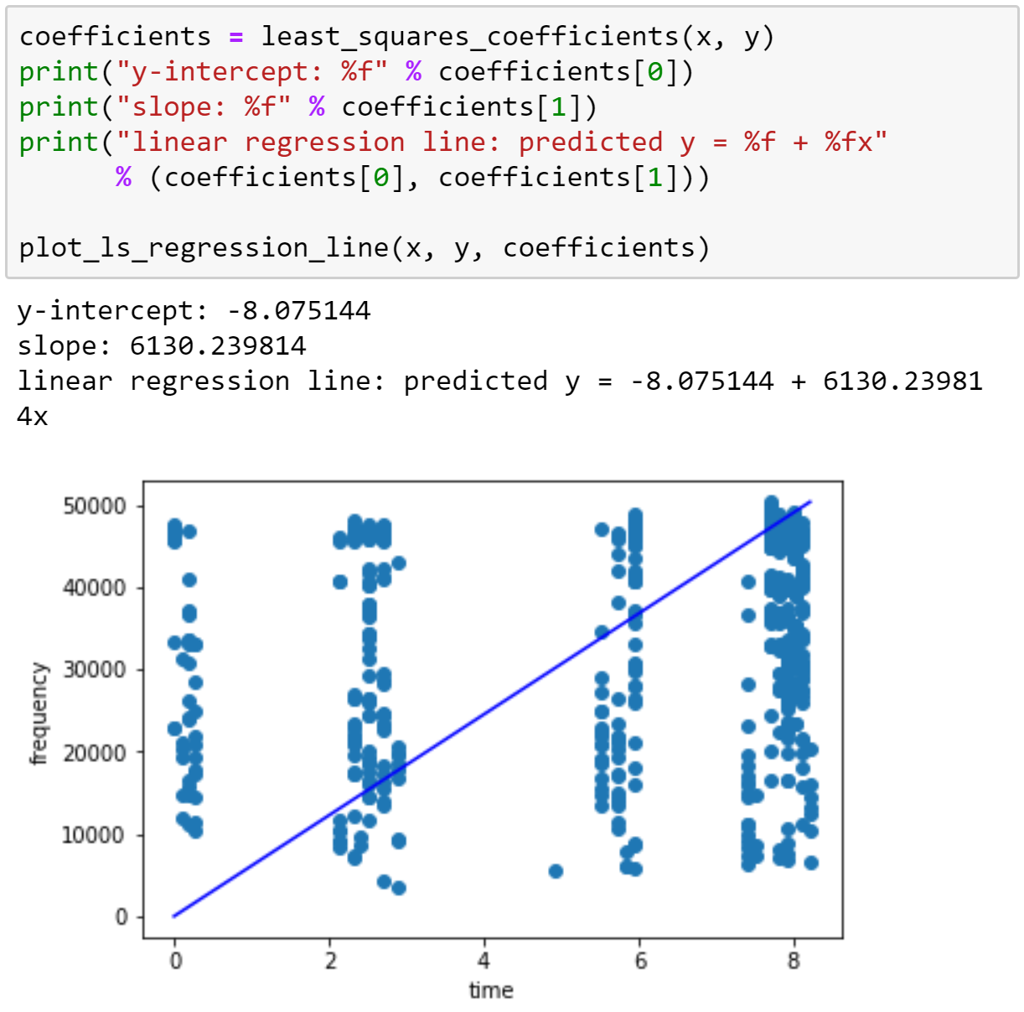
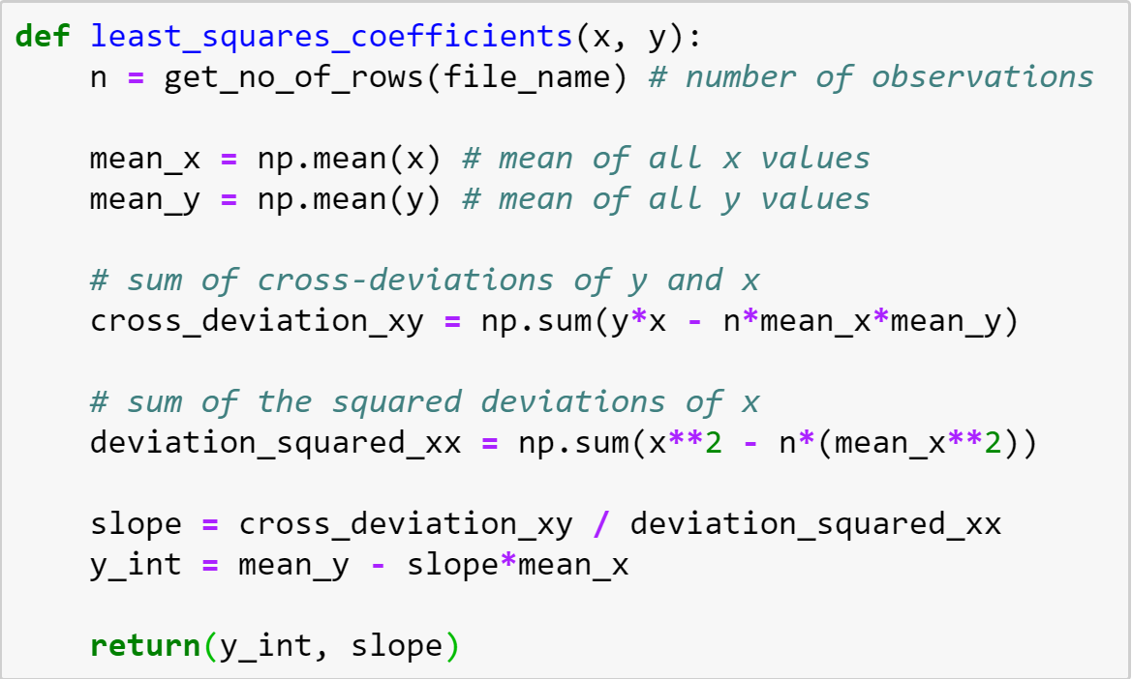
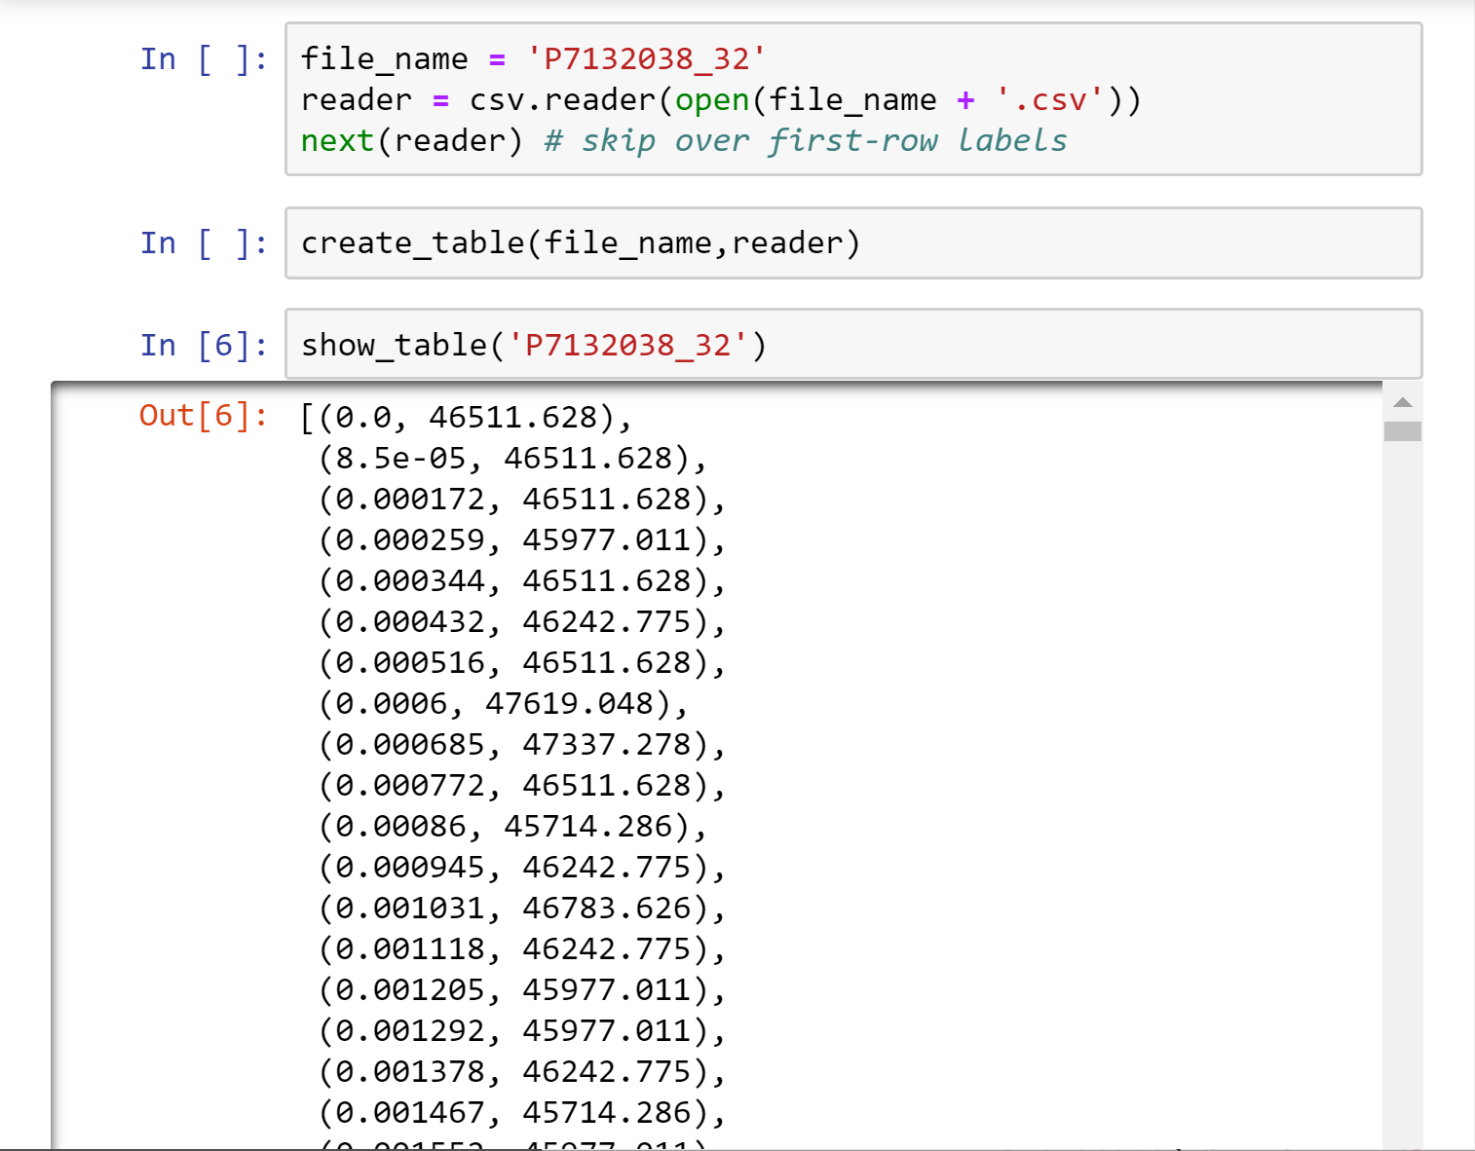
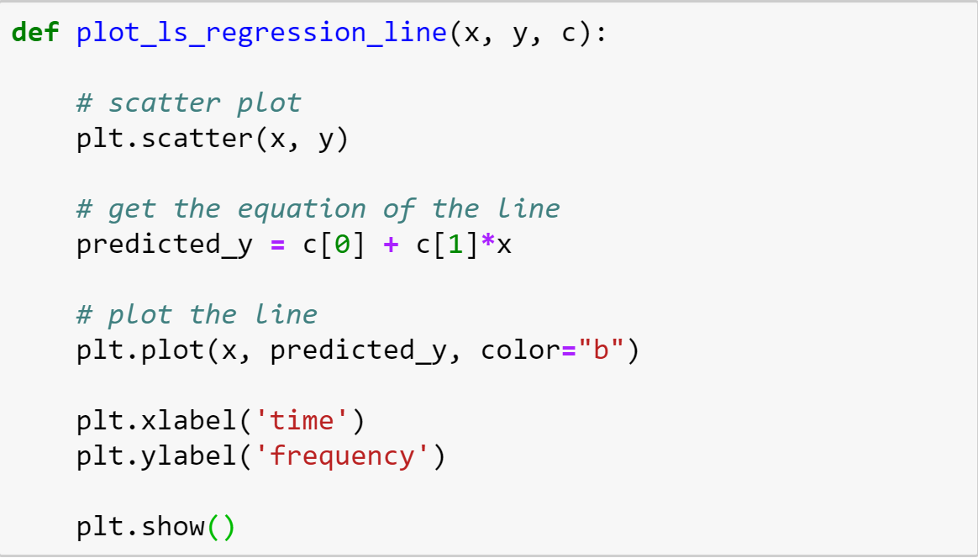
Progress - Kevin (Database)
Progress - Kevin (Linear Regression)

Slide 8
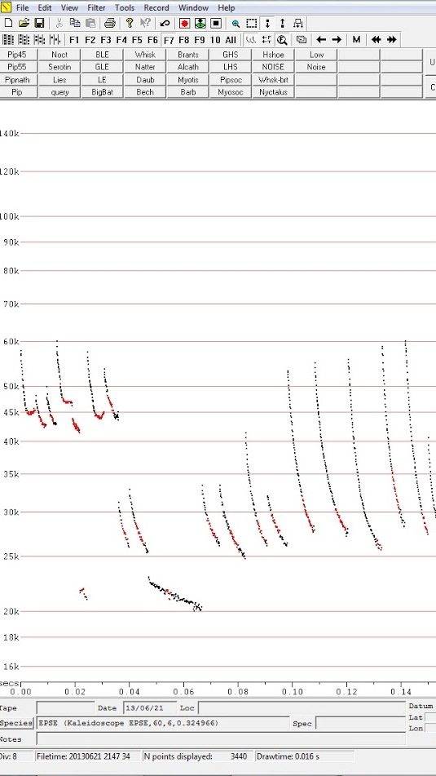
THE DATA
Bat calls are stored in Zero-Crossing form. The purpose of a given call can be determined by the shape of it’s sweep.
The data is noisy and most calls are uncategorized. We have to devise techniques to work past these issues.
Notes:
How is the data collected and what they are - Thien
---There are microphones set up all around nc for about a year.
---Use the kaleidoscope program to convert audio files to the zero crossing. We use the Analook program to observe those files.
---Frequency recordings of bat calls at over 100 sites across the state or NC, including at the UNCG Wetlands. This generates hundreds of thousands of recordings, and extracted information from the recordings on bat species, and other behaviors like the production of social calls. • The data is processed into a graph in which the dominant frequency sweep through time can be easily visualized. It’s stored as bytes which contain the time and frequency intervals between each point on the graph.
The challenges - Hadi
Noise removal: files have a lot of random noise from a variety of environmental sources. In order to extract meaningful signals noise has to be removed
Signal extraction: once the noise is removed, how do we process the pulses? There are some advantages to using discrete points (startup speed, AI) and some disadvantages (traditional statistics, runtime speed)
Signal analysis: once we have pulses, we have to categorize them according to shape

Slide 9
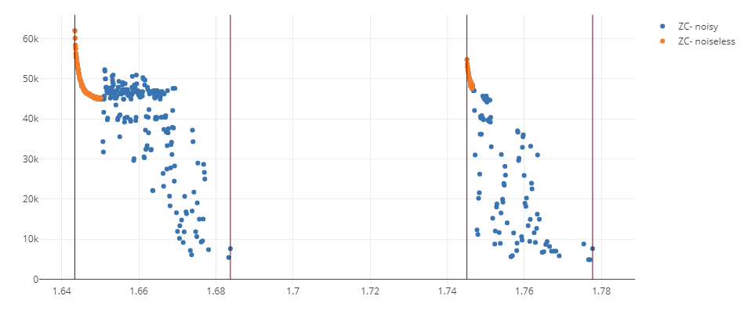
Noise removal
Notes:
This is a sample of my algorithms results so far. As you can see its very effective, only ignoring 4 or 5 points that are considered good data. It works by chunking a file into pulses, generating a smoothed graph of each pulse, and removing parts of the pulse that are too different from the smooth graph.

Slide 10
Statistics-Hadi
Most ZC points occur within .002s of one another (>90%)
Files are ~80% noise
Echolocation calls
Occur between 40khz and 60khz
Are ~.004 seconds long
Points occur within .0001 of one another
Notes:
Due to the nature of our data, we've had a hard time doing meaningful statistics. the tools we need to do it just aren't ready yet. That being said, I have a little bit of information to report.

Slide 11
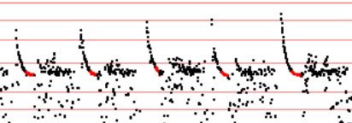
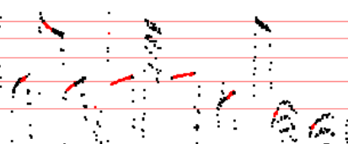
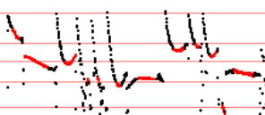
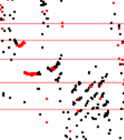
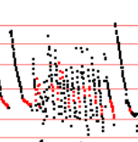
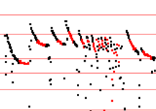
Progress - Yang Peng
---Normal calls:
---Social calls:
---Foraging calls:
Notes:
librosa data visualization package
Task by Member
Progress made towards the task.
If background research - describe it.
If coding - show outcomes.

Slide 12
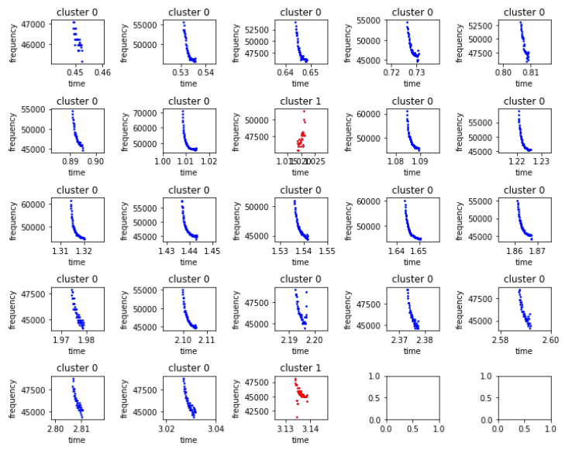
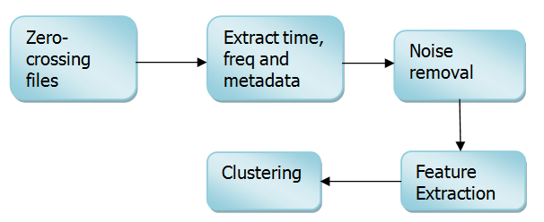
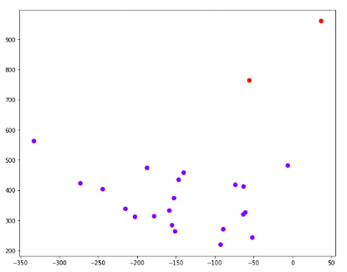
Progress - Yang Peng
Initial clustering analysis:
Notes:
librosa data visualization package
Task by Member
Progress made towards the task.
If background research - describe it.
If coding - show outcomes.

Slide 13
Tasks - Yang Peng
Completed:
1. Wrote data dictionary and README.md
2. Performed descriptive analysis for dataset
3. Built a bat.py module including 4 functions for data extraction, preprocessing and visualization
4. Did an initial clustering analysis
To-do:
1.Improve noise removed method
2.Improve clustering analysis
3.Research on classification
Notes:
librosa data visualization package
Task by Member
Progress made towards the task.
If background research - describe it.
If coding - show outcomes.

Slide 14
Tasks - Thien Le
Completed:
1. Initialized the Website using Django
2. Create Models and Use Django Admin
3. Integrated Chart.js with Django to display a more user friendly views for the user.
To-do:
1. Incorporate the extracted data and present it through the use of Django and Chart.js
2. Allow the user to be able to customize the graph(rename, edit, favorite)
3. Integrate and communicate to a small local database.
Notes:
librosa data visualization package
Task by Member
Progress made towards the task.
If background research - describe it.
If coding - show outcomes.

Slide 15
Tasks - Bety R
Completed:
1. Multiprocessing zero crossing files using R-package;
2. Feed in multiple .csv to Python;
3. Create workflow for procedure.
To-do:
1. Perform multiprocessing with ZCANT in Python;
2. Baseline normalization to allow one-file analysis;
3. Automate workflow.
Notes:
librosa data visualization package

Slide 16
Tasks - Kevin K
Completed:
1. Began building a database for storing cleaned bat calls
2. Developed and implemented linear regression algorithm
To-do:
1. Establish live access to database
2. Complete database with tables for each sweep
3. Calculate lin. reg. for each sweep
4. Place each sweep into normal and abnormal groups
Notes:
librosa data visualization package

Slide 17
Tasks - Hadi S
Completed:
1. Implemented several algorithms for noise filtering
Derivative
Algorithmic smoothing
Machine learning techniques
To-do:
1. Improve noise filtering
Focus on algorithmic smoothing
2. Research clustering algorithms
Notes:
librosa data visualization package

Slide 18
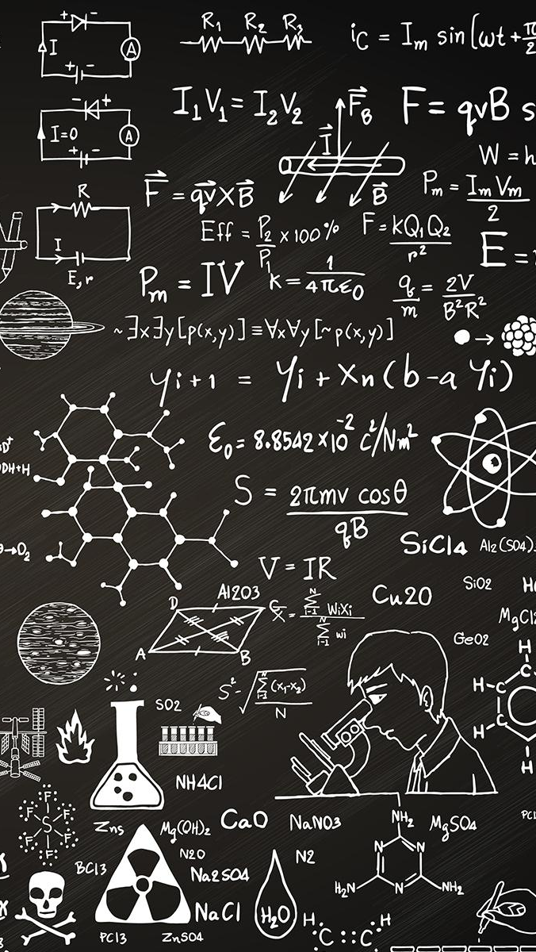
THANKS!
Any questions?

